Slide 1
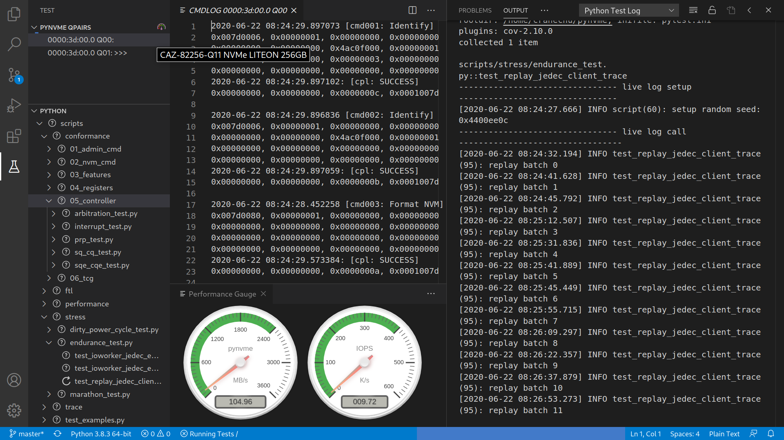

Notes:
储鹤
cranechu@gmail.com
v1.9

Slide 2
Requirement
Notes:
储鹤
cranechu@gmail.com
v1.9

Slide 3
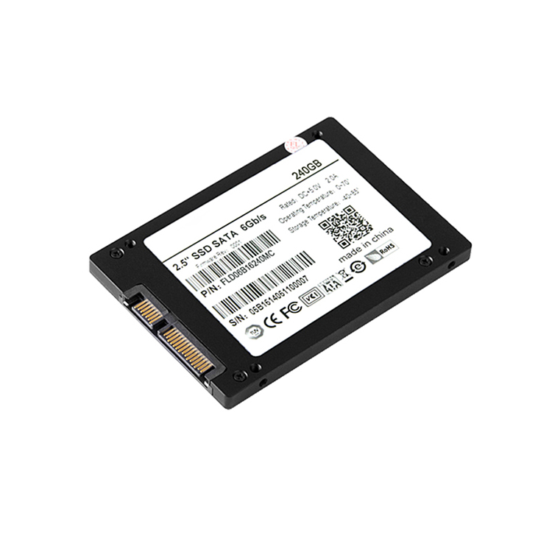
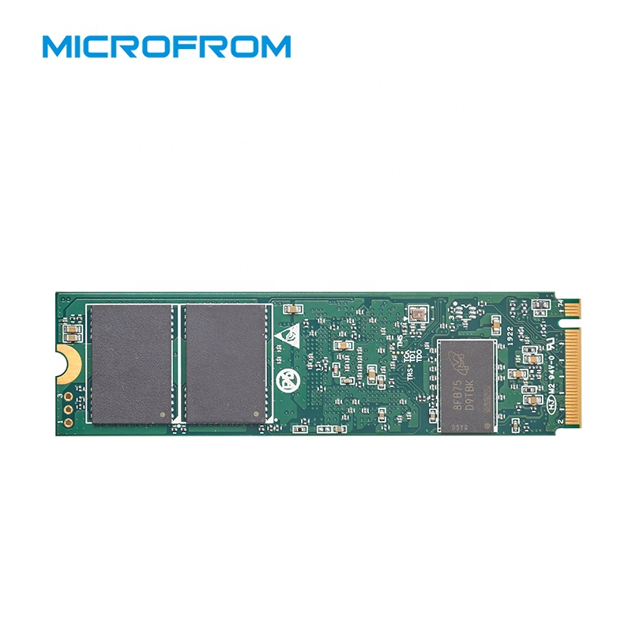
Changes in SSD
SSD has been changing for the decade:
media:
SLC, MLC, TLC, QLC
2D => 3D
PCM, 3D-Xpoint...
host:
PATA, SATA, PCIe/NVMe
open-channel
up coming: ZNS, KV, ... ?
DRAM
form factor
Agile: good for the constant change and uncertainty

Slide 4
Agile Testing
Developing and Testing are done interactively and iteratively.
QA verifies the product of Dev/Test for customers.
Testing and QA are different. Testing tools and QA tools are also different.
Most available tools in the market are QA tools.
test | QA
for developer | for customer
before checkin | before release
automatic | manual
white-box | black-box
short | long
changing | stable
Developing
Testing
QA
Release

Slide 5
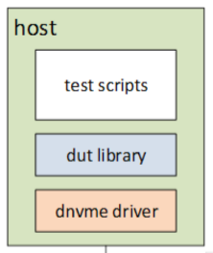
Experience in a Startup: dnvme
dnvme: @2015
wrap with python in userspace
functional tests
integrited with Jenkins
firmware engineers develop scripts
PASS IOL test on the first try
challenges:
low performance:
IOPS, latency, consistency
test efficiency
stress tests
maintainness: kernel module
function coverage: PRP, ...
GPL License
dnvme is good at NVMe test, but in-efficient on SSD test.
Notes:
FE开发测试脚本
如果你要发布修改后的版本就要连源代码一起公布。GPL要求GPL代码开放的继承性，即确保所有GPL代码的派生工作的开放性。而BSD许可证则相对宽泛的多，允许自由使用BSD代码，使用者有权对代码所做的修改进行保密，不要求BSD代码派生工作的开放性。

Slide 6
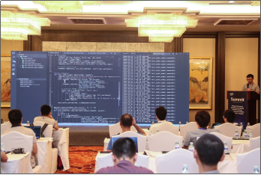
Born for NVMe: SPDK
SPDK is open from 2016
super high performance: 10M IOPS
user space application
based on DPDK environment, which abstracts low-level resources
PCIe
memory
meet challenges:
low performance:
IOPS, latency, consistency
test efficiency
stress tests
maintainness: kernel module
function coverage: PRP, ...
BSD License
Notes:
FE开发测试脚本

Slide 7
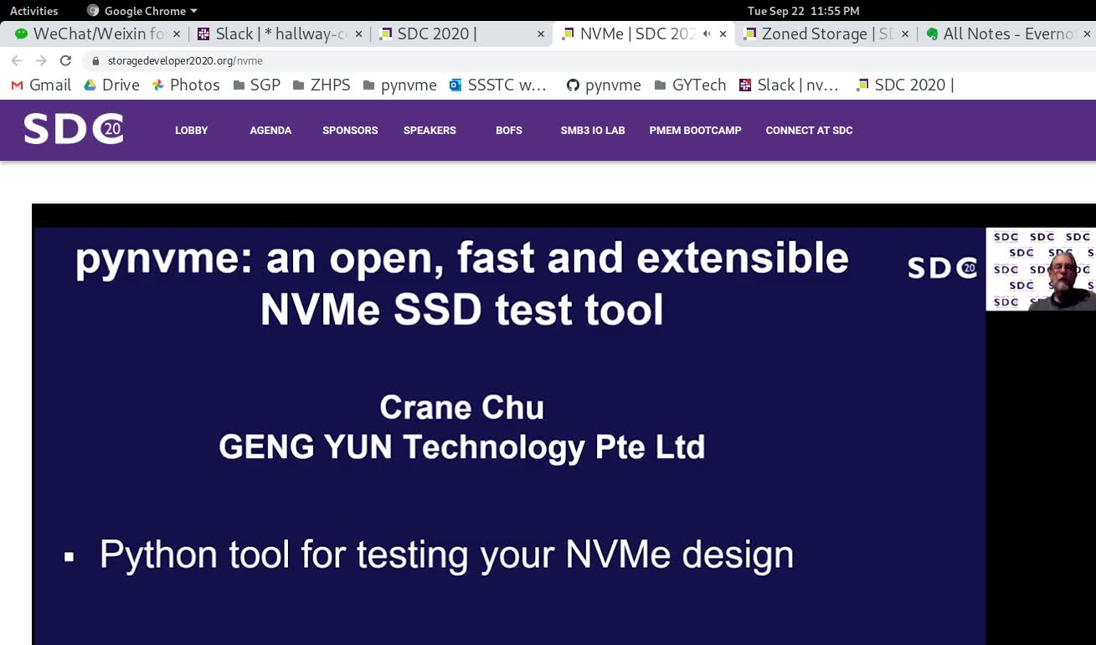
SDC2020
https://www.youtube.com/watch?v=Yoru7vzVyL8
Notes:
FE开发测试脚本

Slide 8
Design
Notes:
储鹤
cranechu@gmail.com
v1.9

Slide 9
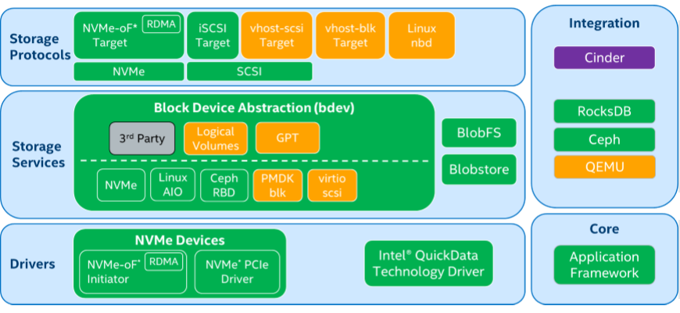
SPDK

Slide 10
SPDK/DPDK
Moving all of the necessary drivers into userspace, which avoids syscalls and enables zero-copy access from the application.
Polling hardware for completions instead of relying on interrupts, which lowers both total latency and latency variance.
Avoiding all locks in the I/O path, instead relying on message passing.

Slide 11
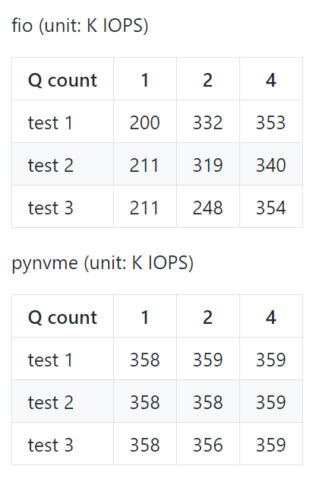
Performance
Notes:
性能更好，消除host软件的性能瓶颈，一个queue就可以达到最大性能。
性能更稳定，一致性更好
CentOS 7

Slide 12
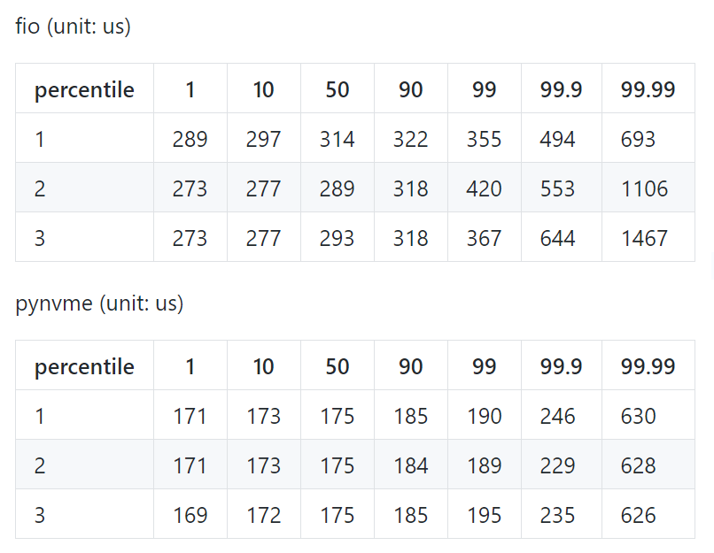
Performance: latency
Notes:
延迟低，并且稳定
CentOS 7

Slide 13
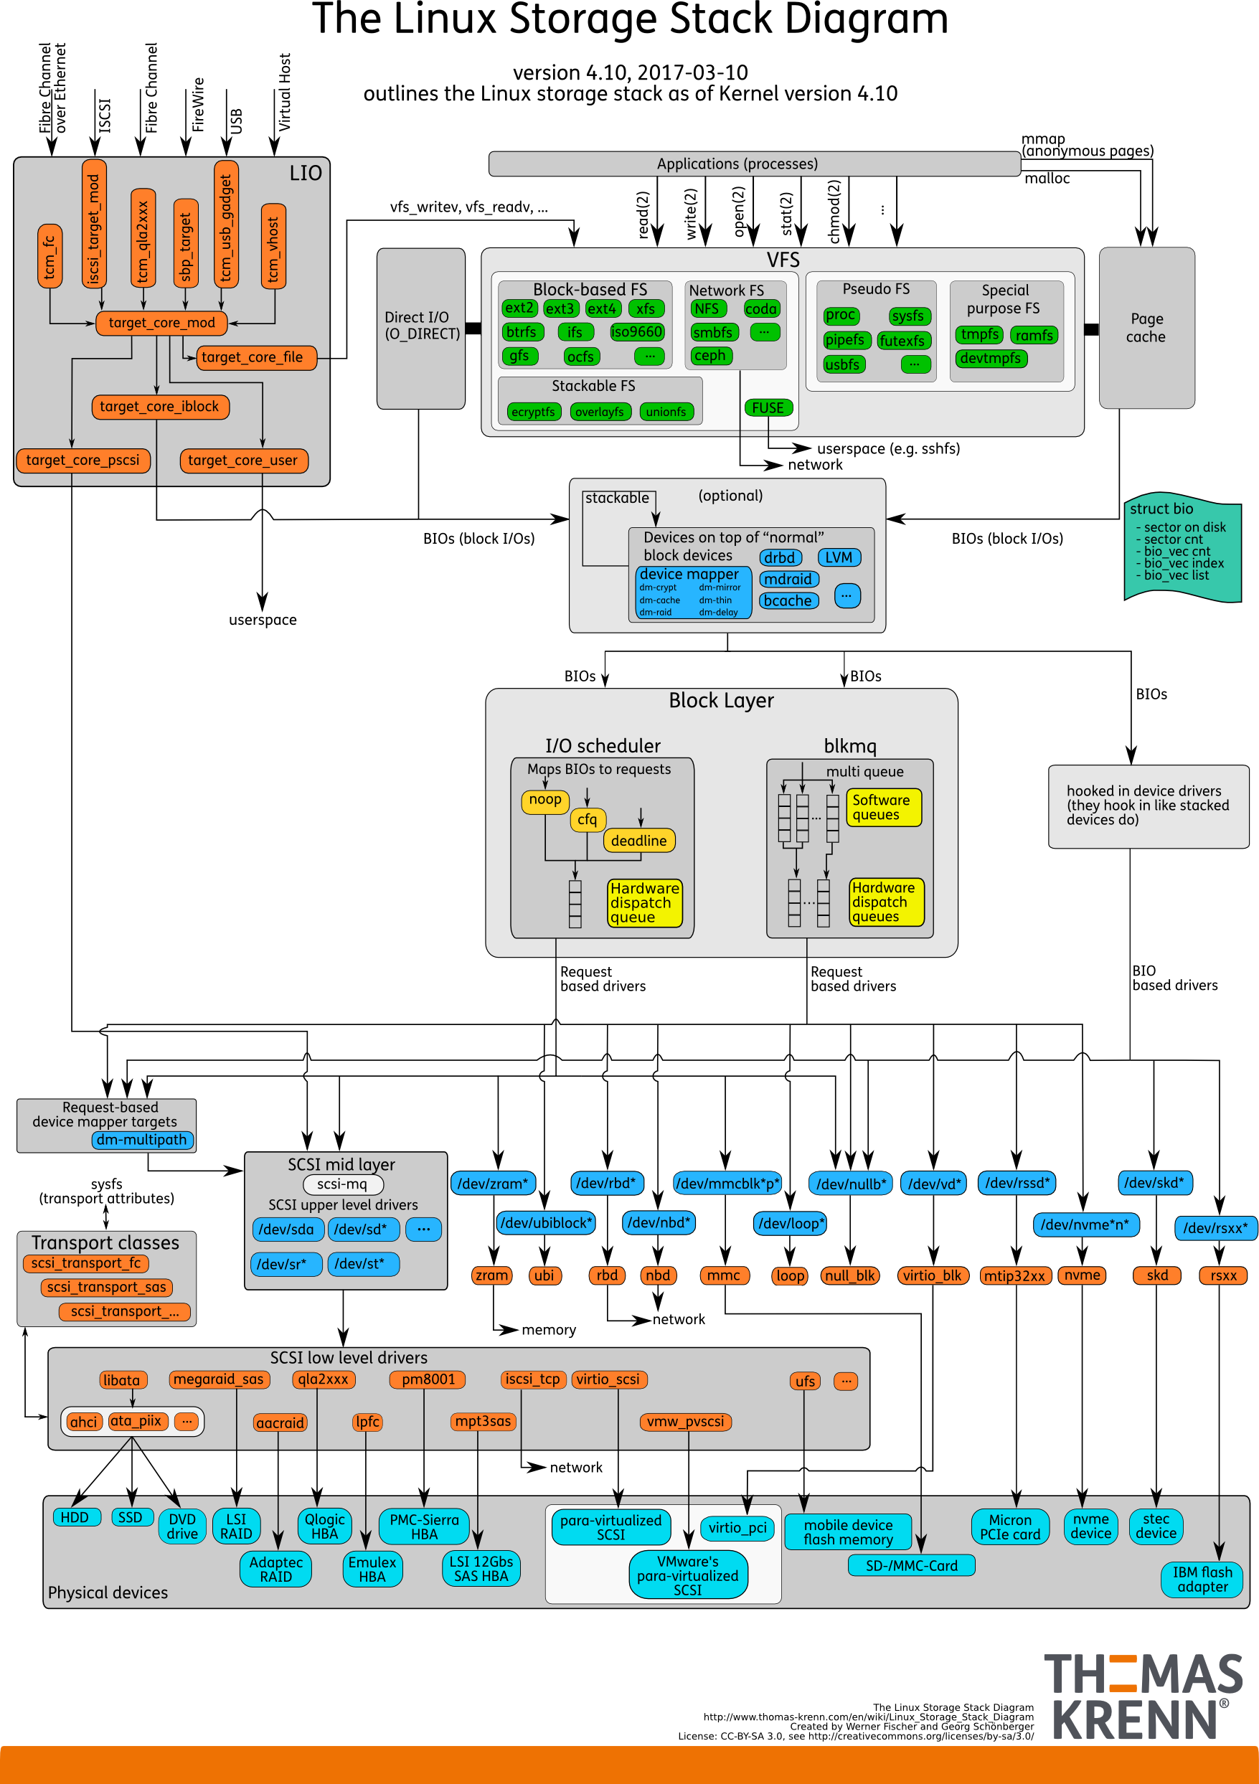
Performance: design
FIO
pynvme
NVMe driver
in userspace
DUT
Notes:
内核是一个庞大的兼顾各种应用的软件架构，但也引入和大量的延迟和不确定性。
FIO和大量其他测试工具要走完整的内核调用

Slide 14
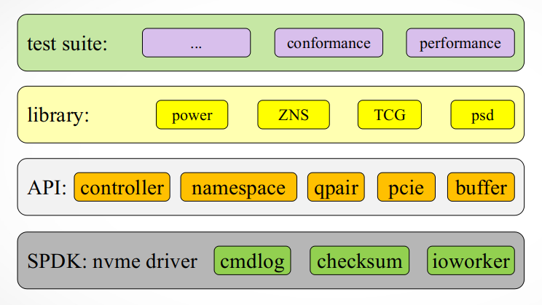
Architecture
scripts
driver

Slide 15
psd: Python Space Driver
psd:
IOSQ
IOCQ
SQE
CQE
PRPList
API:
controller
namespace
qpair
pcie
buffer
SPDK: nvme driver
cmdlog
checksum
ioworker
NVMe SSD

Slide 16






Open Ecosystem

Slide 17
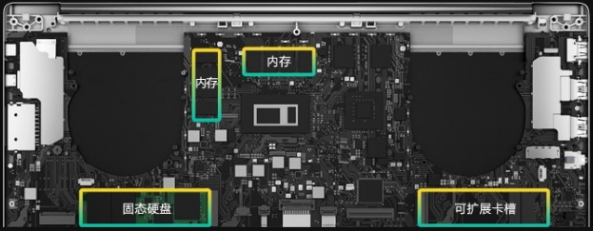
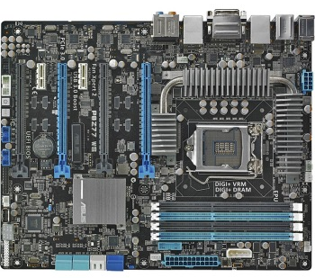
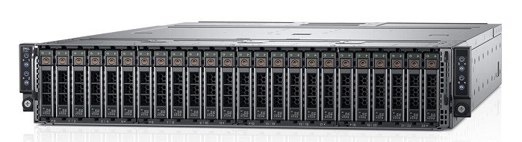
Flexible Hardware Configuration
Single Node
laptop
workstation
Mass Deploy
server
Notes:
配置灵活
搭配开源软件

Slide 18
Install and Test
git clone https://github.com/pynvme/pynvme
cd pynvme
./install.sh
make setup
make test TESTS="driver_test.py::test_ioworker_iops_multiple_queue[1]"
make test TESTS=scripts/stress/endurance_test.py::test_replay_jedec_client_trace pciaddr=02:00.0
make test TESTS=scripts/stress/endurance_test.py::test_replay_jedec_client_trace pciaddr=172.168.5.44

Slide 19
Scripts
Notes:
储鹤
cranechu@gmail.com
v1.9

Slide 20
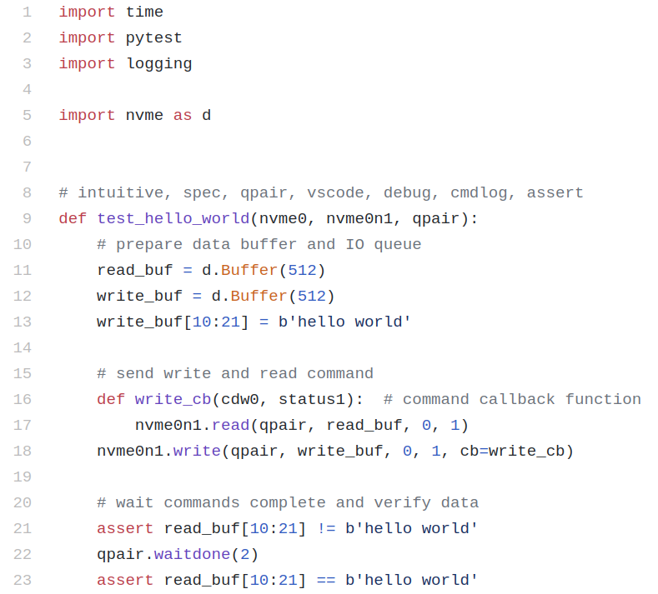
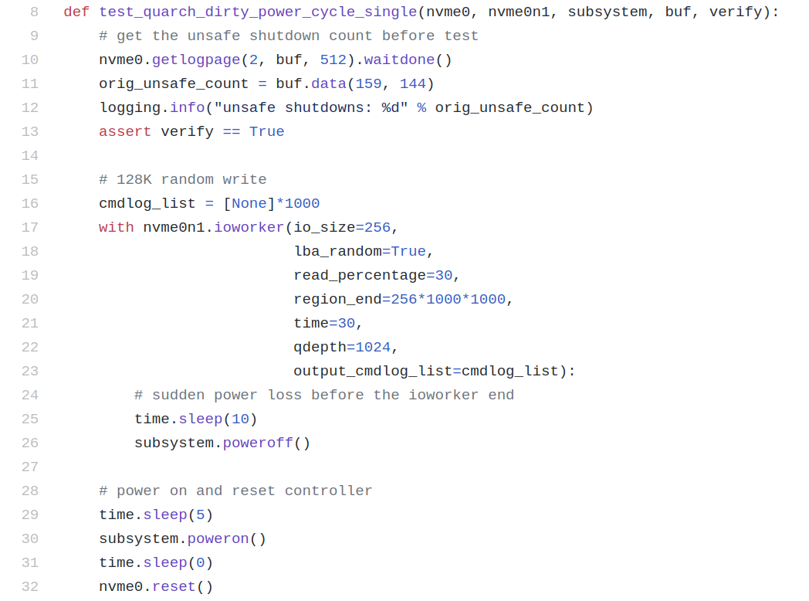
Test Scripts
Notes:
原汁原味的python，接入python强大的脚本库
易于理解和沟通
方便开发人员快速写脚本
测试FW，
缩小debug范围
conformance
自动化

Slide 21
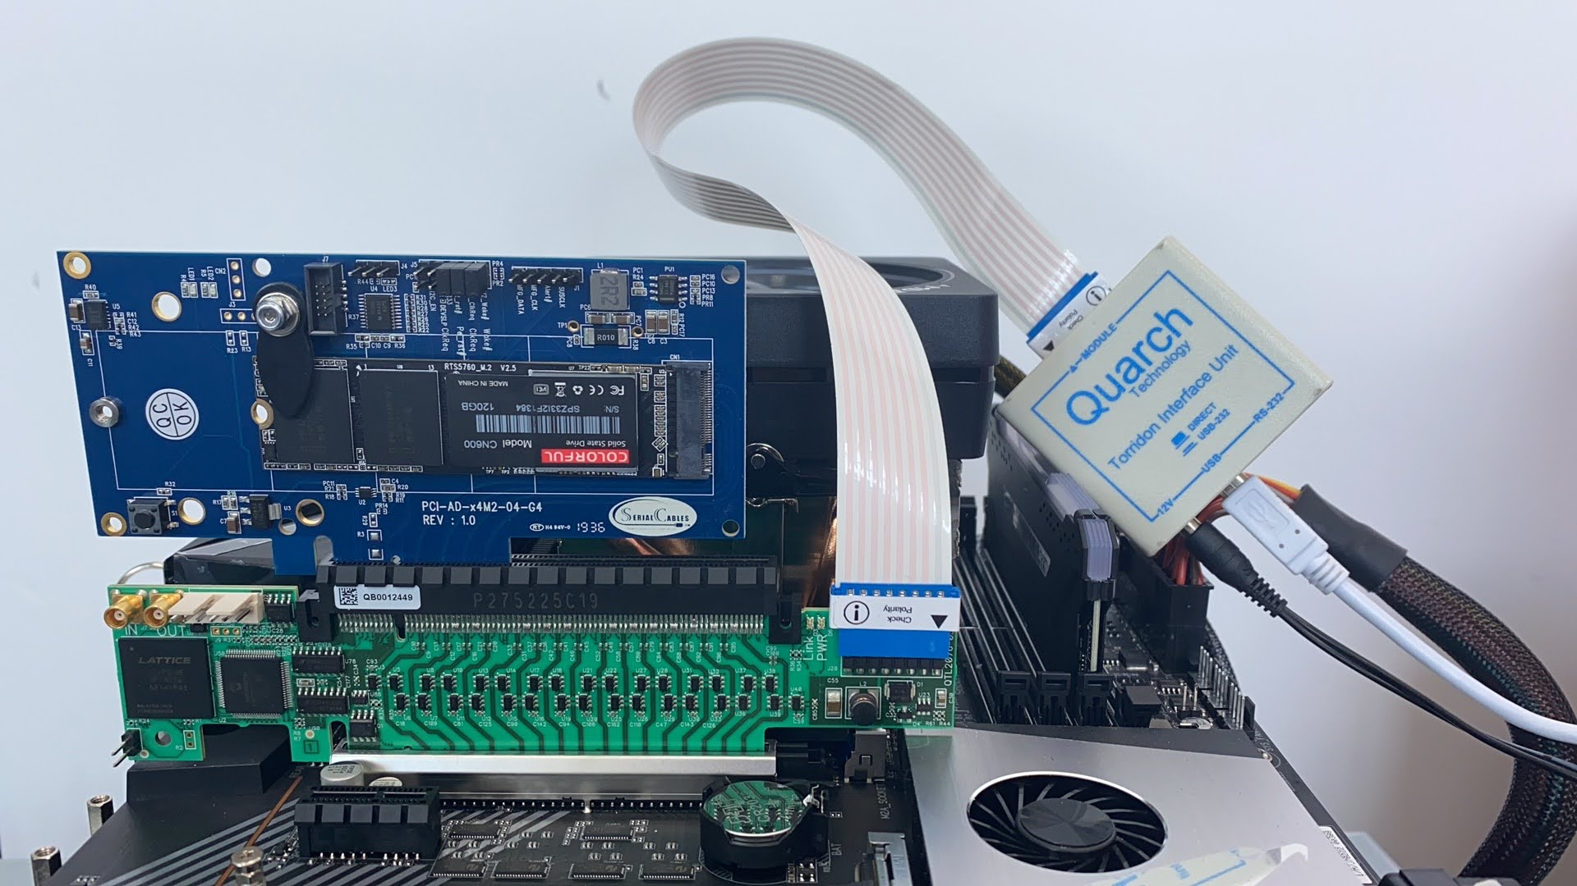
Test Scripts: dirty power cycle
Quarch
PCIe Card Module
Torridon Interface Kit
PAM
3-rd party fixtures supported
poweroff process
poweroff when ioworker is alive
remove device from system
poweron process
poweron
remove kernel driver
rescan device
nvme initialization
Notes:
电源开关控制：单路，盘柜16， 24，...
物理层压力测试：电压拉偏，lane断开，信号毛刺
1000 loop pass

Slide 22
Features
access PCI configuration space
access NVMe registers in BAR space
send any NVMe admin/IO commands
support callback functions for NVMe commands
support MSI/MSIx interrupts
transparent checksum verification on every LBA
generates IO workload of high performance and low latency
support multiple namespaces
support multiple tests on different controllers
integrate with the test framework pytest
integrate with VSCode to display cmdlog in GUI
support NVMe over TCP targets
doc: https://pynvme.readthedocs.io/

Slide 23
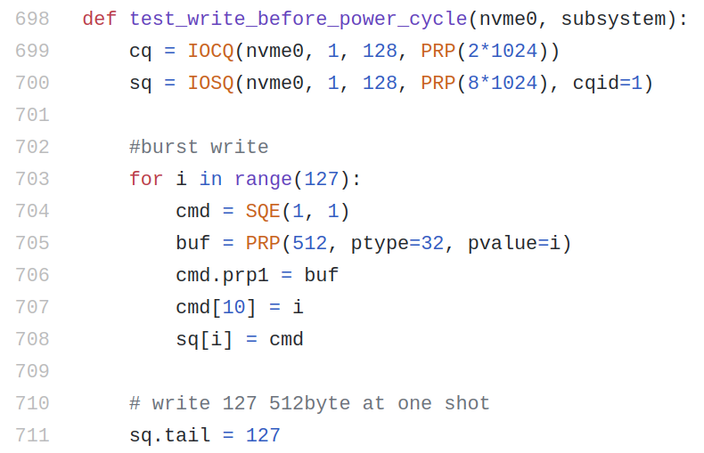
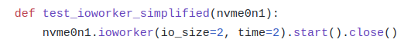
Test Scripts: 3 ways of sending IO
Notes:
性能和可扩展性的取舍和平衡

Slide 24
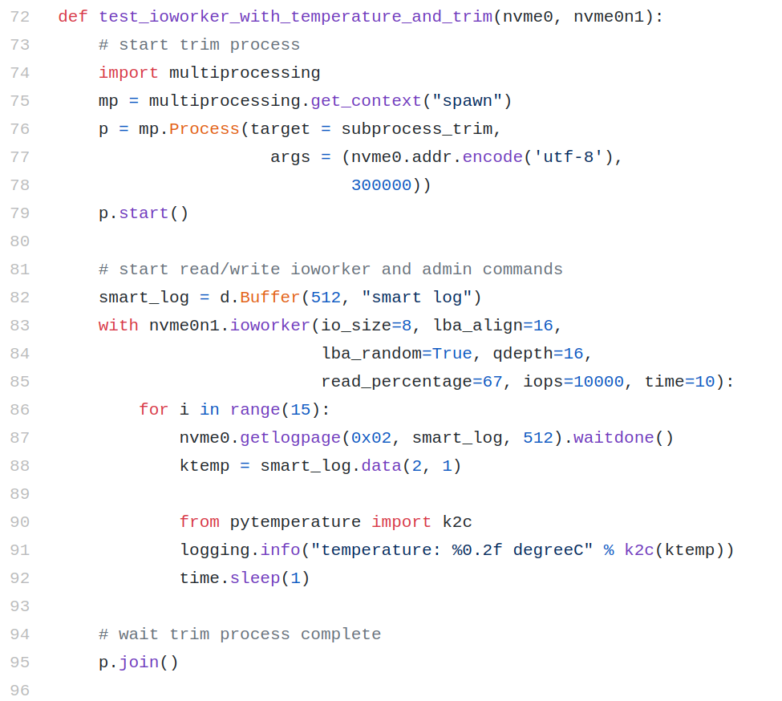
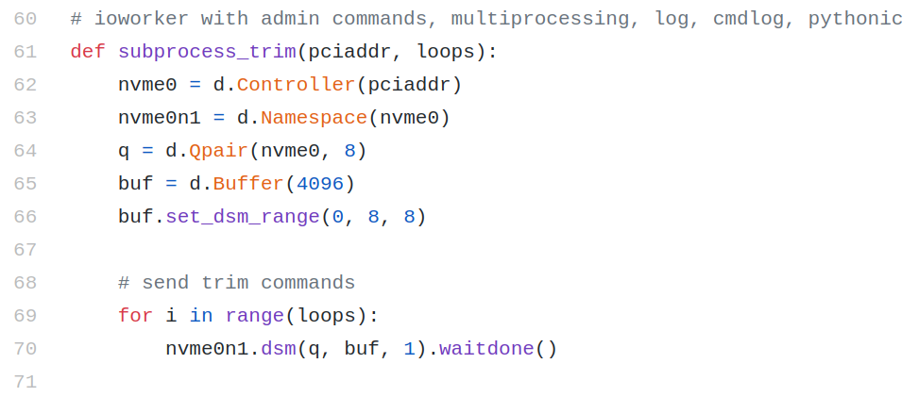
Test Scripts: multiprocessing
main process
subprocess
subprocess
getlogpage
native python
ioworker
join processes
Notes:
单进程ioworker就可以打出最大的IO压力
通过多进程，进一步增加压力，利用多核硬件平台的性能

Slide 25
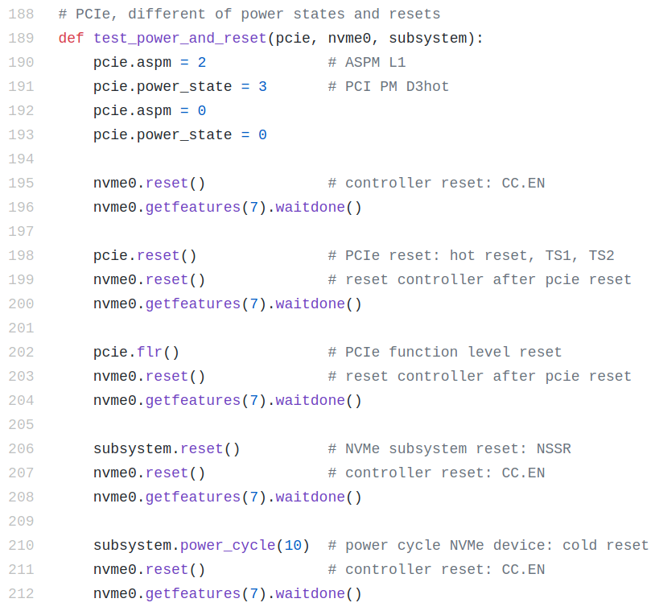
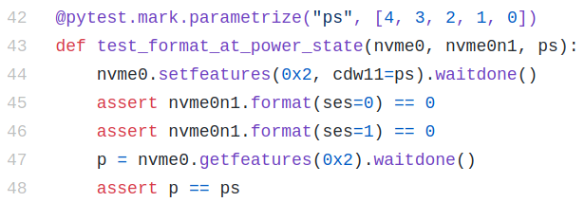
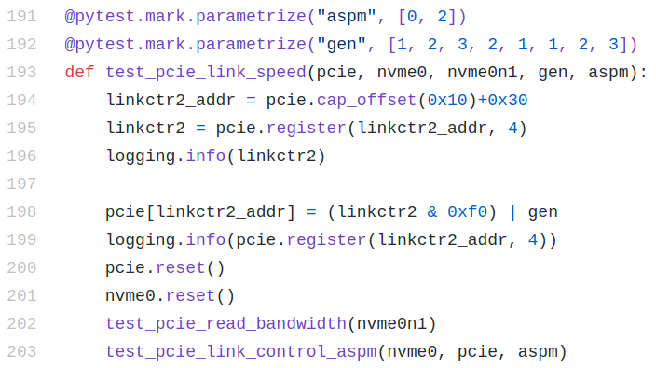
Test Scripts: power related
Notes:
单进程ioworker就可以打出最大的IO压力
通过多进程，进一步增加压力，利用多核硬件平台的性能

Slide 26
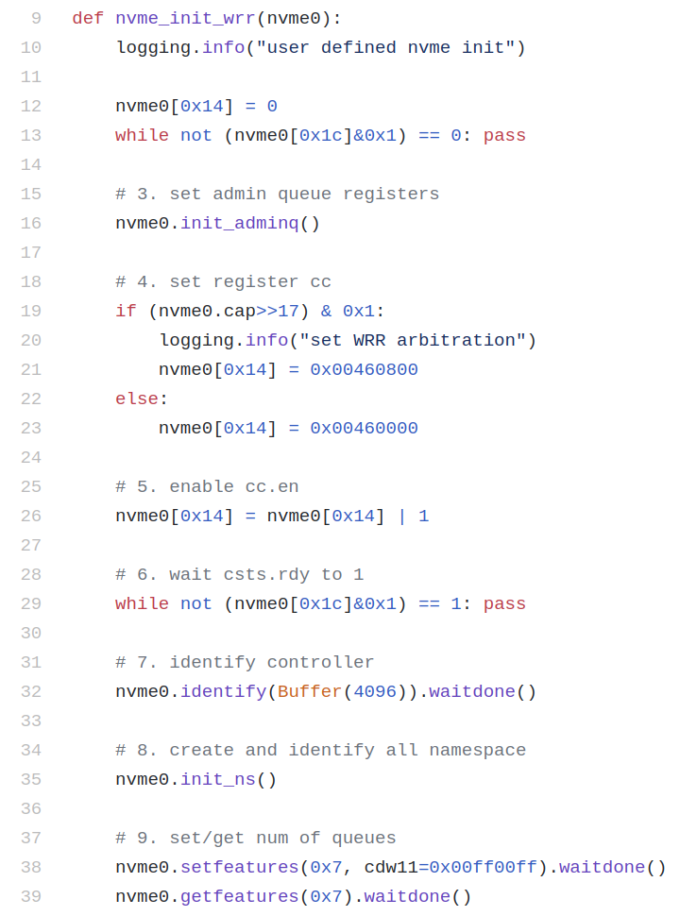
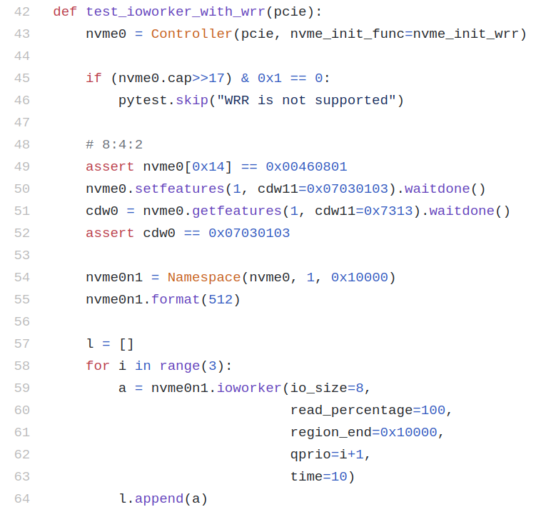
Test Scripts: NVMe initialization for WRR
Notes:
用户可以在脚本中自定义初始化的过程，譬如这里会enable WRR
ioworker支持设定queue prio

Slide 27
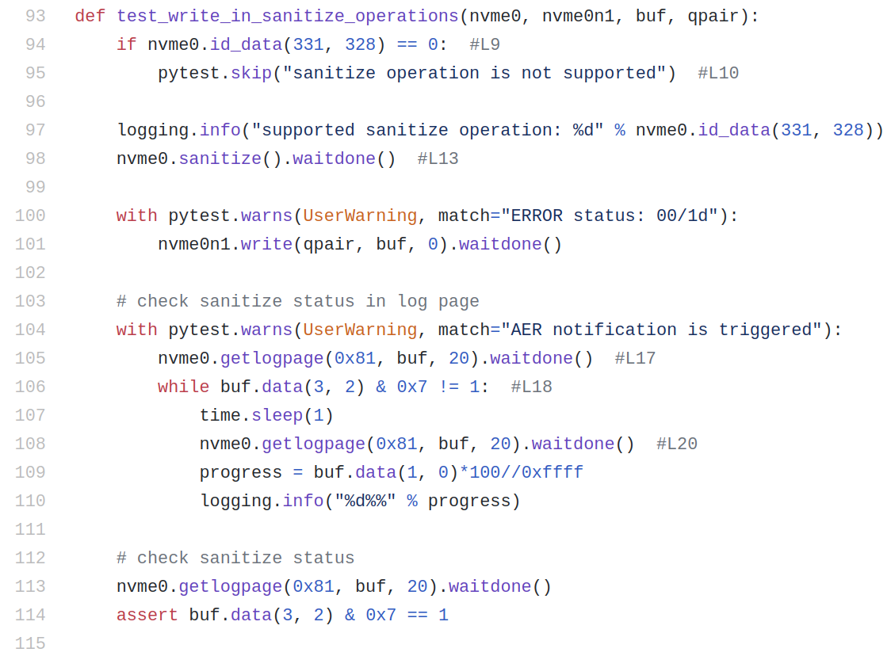
Test Scripts: error code
Notes:
单进程ioworker就可以打出最大的IO压力
通过多进程，进一步增加压力，利用多核硬件平台的性能

Slide 28
ioworker
Notes:
储鹤
cranechu@gmail.com
v1.9

Slide 29
ioworker: Parameters
Input Parameters:
lba_start, lba_step, lba_align
lba_random
region_start, region_end
distribution
io_size (int, range, list, dict)
read_percentage, op_percentage
time, io_count
qdepth, qprio
pvalue, ptype
iops
...
Output Parameters:
io_count_read
io_count_write, io_count_nonread
mseconds
latency_max_us
latency_average_us
error
cpu_usage
output_io_per_second (optional)
output_percentile_latency (optional)
output_cmdlog_list (optional)
...
API document: https://pynvme.readthedocs.io/api.html
Notes:
ioworker的输入参数和输出结果
可以同时建立多个ioworker，可以工作于多个不同的设备，不同的参数
可以看作一个python接口的fio，但性能比fio更好。

Slide 30
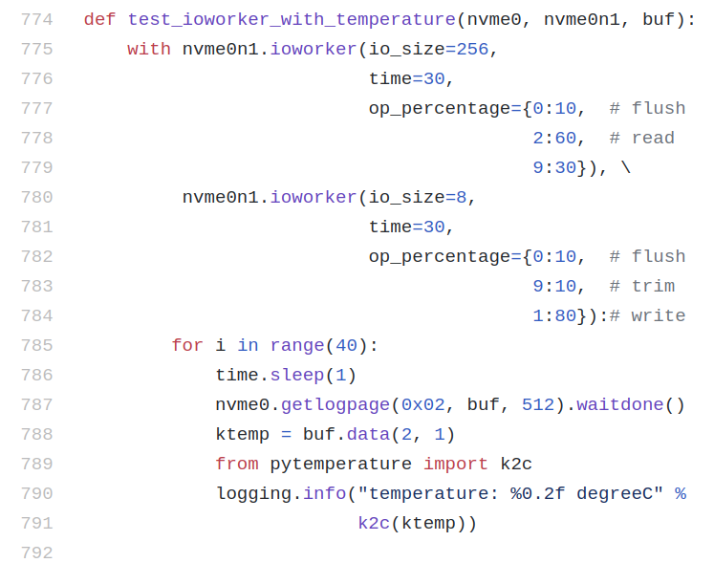
ioworker: Python API
Notes:
单进程ioworker就可以打出最大的IO压力
通过多进程，进一步增加压力，利用多核硬件平台的性能

Slide 31
ioworker: Gallery
Notes:
excel 或者python第三方图形库
比简单的数字能反映更多盘的性能特性

Slide 32
Features
Notes:
储鹤
cranechu@gmail.com
v1.9

Slide 33
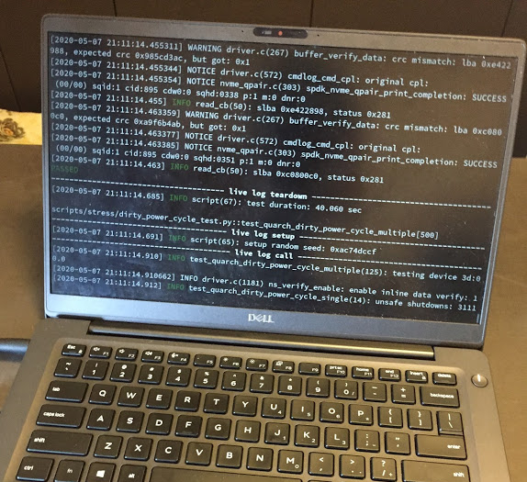
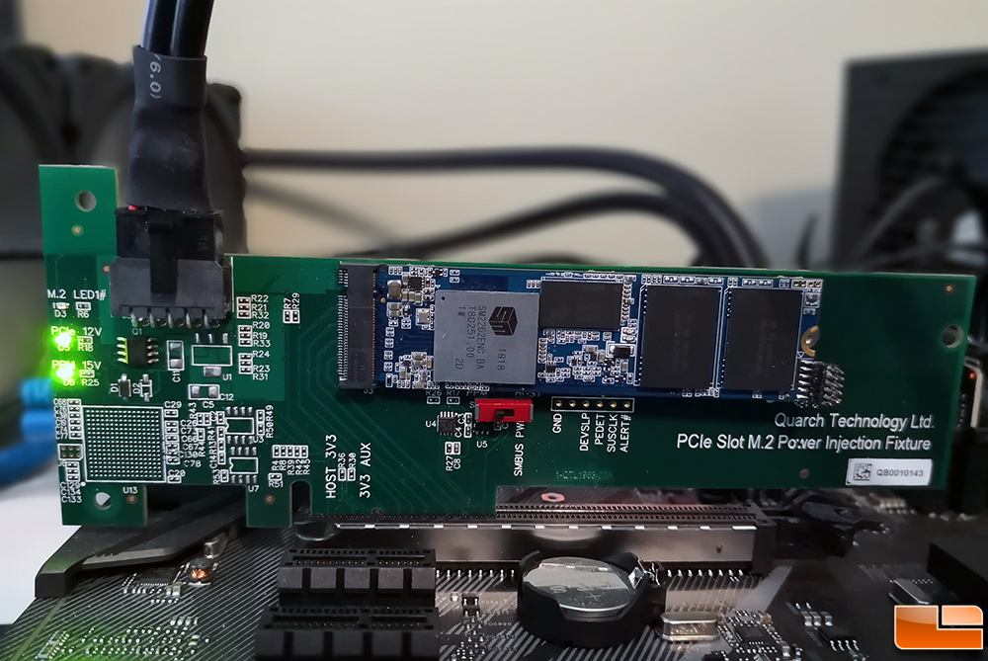
vPower to ON and OFF
Usually we need a special hardware box to control the power of SSD
vPower contorls the power of SSD:
power off: enter S3/sleep mode
power on: wake up by RTC

Slide 34
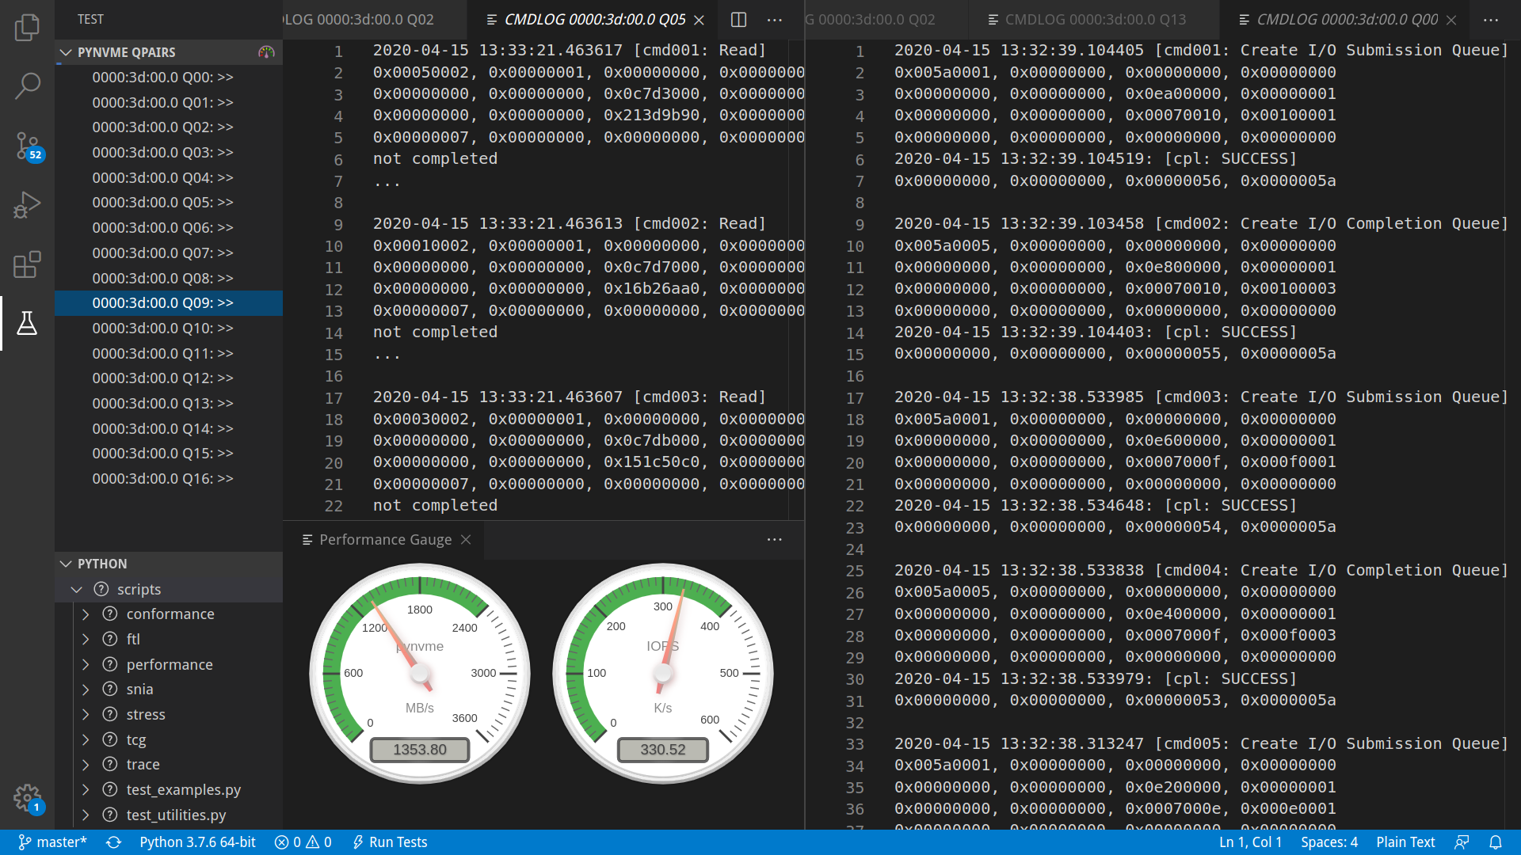
vAnalyzer
Notes:
命令和返回状态
时间
实时性能
使用真正的analyzer，需要让analyzer先抓make setup。

Slide 35



vTracer: IO Recorder and Replayer
Windows 10 Virtual Machine
QEMU with pynvme vSSD
record
replay
pynvme ioworker
Linux
Notes:
Recorder:
qemu: https://github.com/cranechu/qemu/tree/io_recorder_v4.2.0
start qemu with pre-installed win10 drive image
cd ~/pynvme/scripts/trace
/home/cranechu/qemu/build/x86_64-softmmu/qemu-system-x86_64 -m 4096 -drive file=/home/cranechu/vm/win10_100g.qcow2,if=none,id=drv0,discard=on,cache=none -device nvme,drive=drv0,serial=foo -device usb-ehci,id=ehci -device usb-tablet,bus=ehci.0 -enable-kvm -cpu host -smp 4,sockets=1,cores=4,threads=1 | ./recorder.py
box: vnc 127.0.0.1
GUI: stop and save the trace file, start to record new trace file
trace files: *.trace.png
unzip to extract raw trace files
Replayer:
cd ~/pynvme
make setup; code .
run scripts/trace/test_player.py to replay trace file
latency histogram is displayed after replay

Slide 36
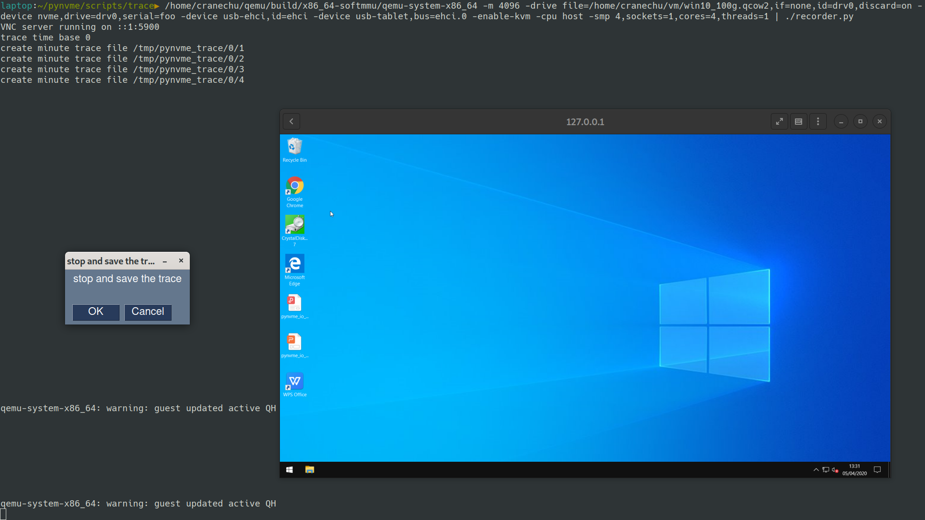
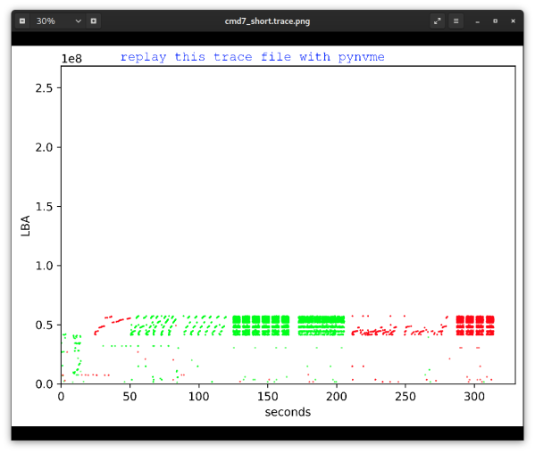
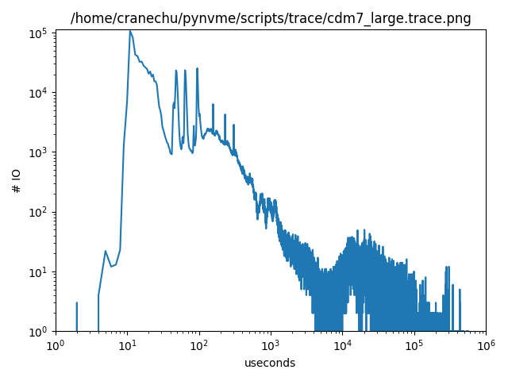
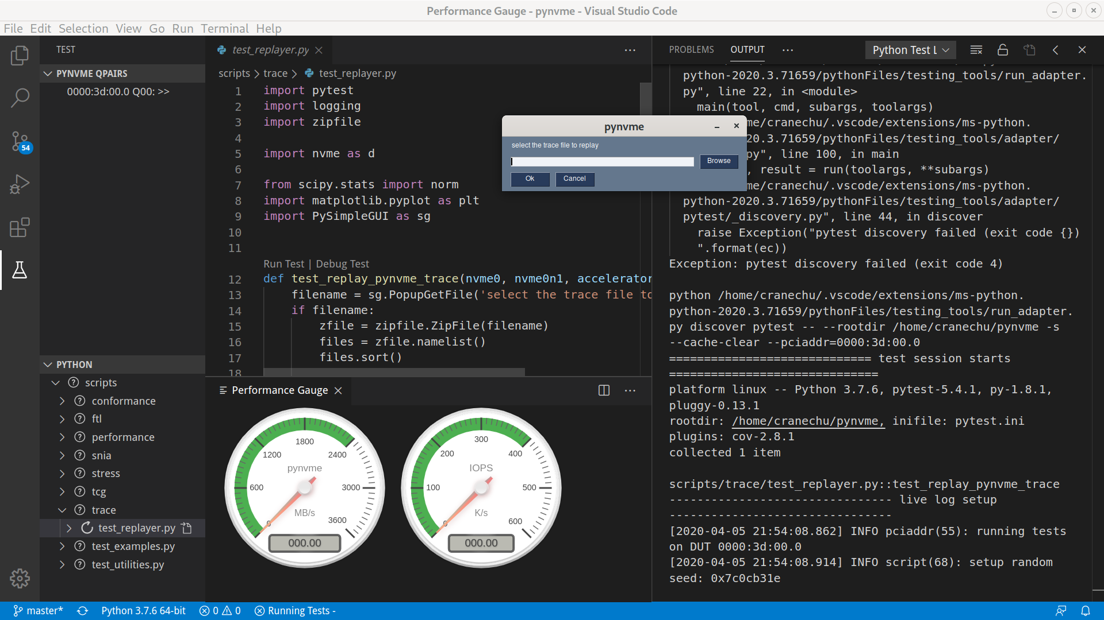
vTracer: Demo

Slide 37
vRunner: Mass Deploy
vRunner 1
Controller Namespace Qpair Subsystem
cmdlog checksum MSIx ioworker
SPDK
PCIe Buffer
vRunner n
DPDK
NVMe SSD 1
NVMe SSD n
Notes:
利用虚拟机技术来大规模部署pynvme: QEMU, VMWare
- iommu, PCIe-passthrough

Slide 38
Services
Notes:
储鹤
cranechu@gmail.com
v1.9

Slide 39
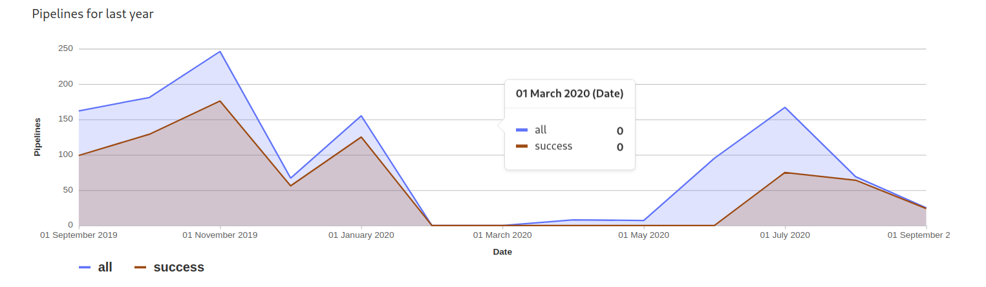
Quality: test of the test infrastructure
CI in gitlab.com
~600 test items
Notes:
对测试工具的测试。
设计上：简单，可靠，尽量利用成熟工具
工程上：敏捷开发

Slide 40

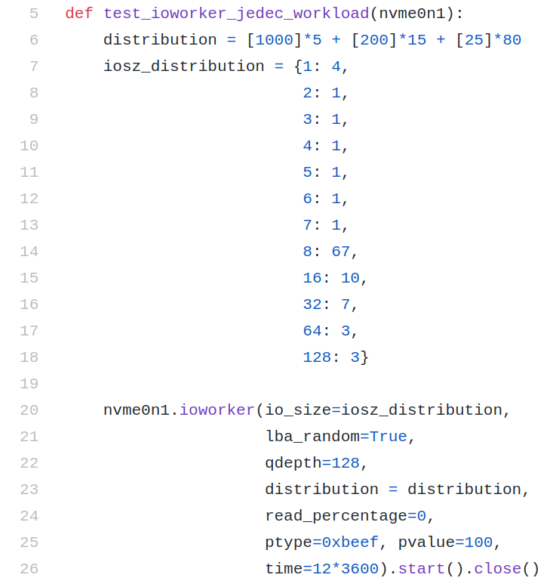


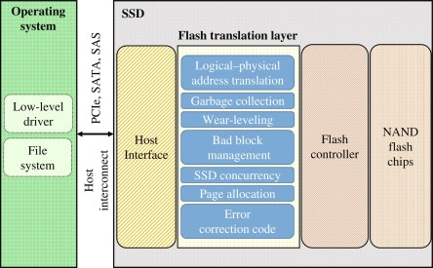
Services
Notes:
协助客户开发脚本，提供行业标准测试的脚本。
client行业的trace replayer and recorder。
移植测试框架和脚本。

Slide 41
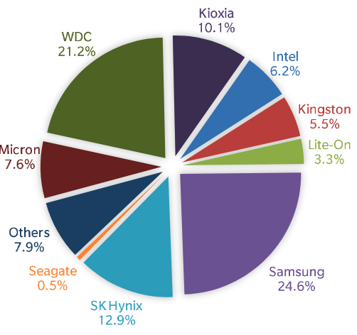
GYTech 耕耘科技
PyNVMe3 is derived from pynvme with more functions and better commercial services. http://pynv.me/3/
the gap between SSD development and test
many SSD controller and product vendors
SSD fast growing
the gap between SSD vendors and customers
3rd party test suites and technology supplier
Notes:
computer has 3 major conponents. compute, memory and storage.
SSD is fast growing in storage market.
many requirement, many product, many vendors
We focus on the storage market
provide test technology and services to vendors.

Slide 42
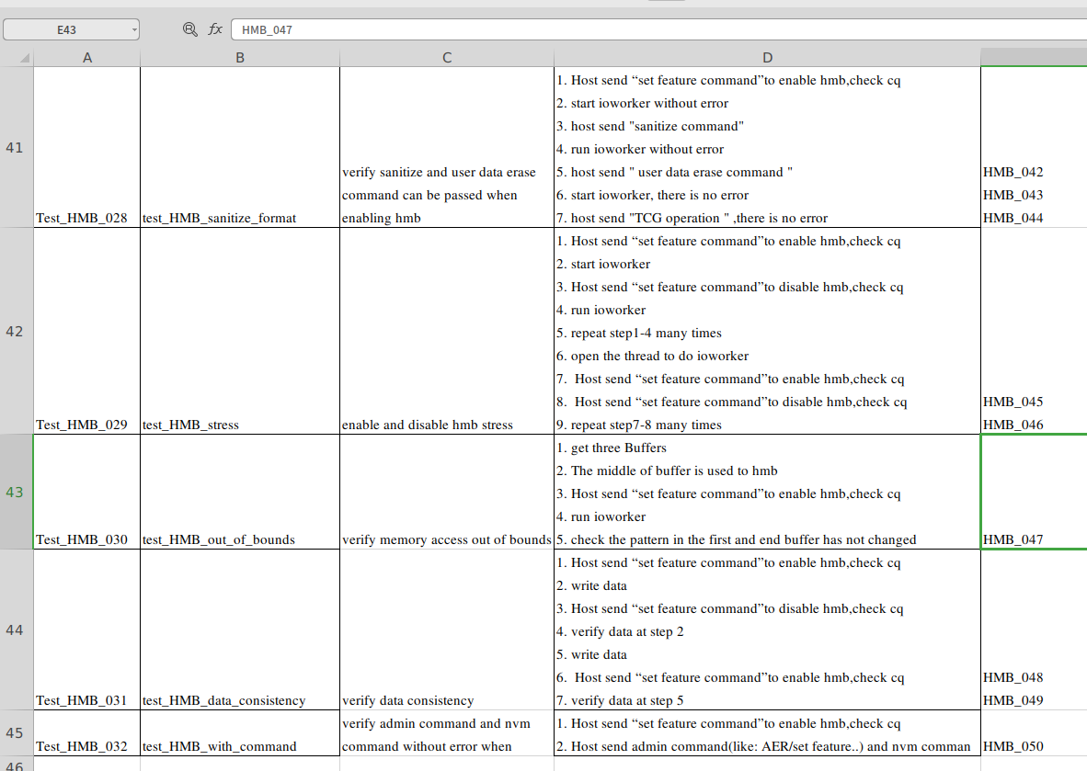
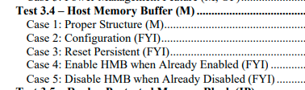
HMB example
5
v.s.
32

Slide 43
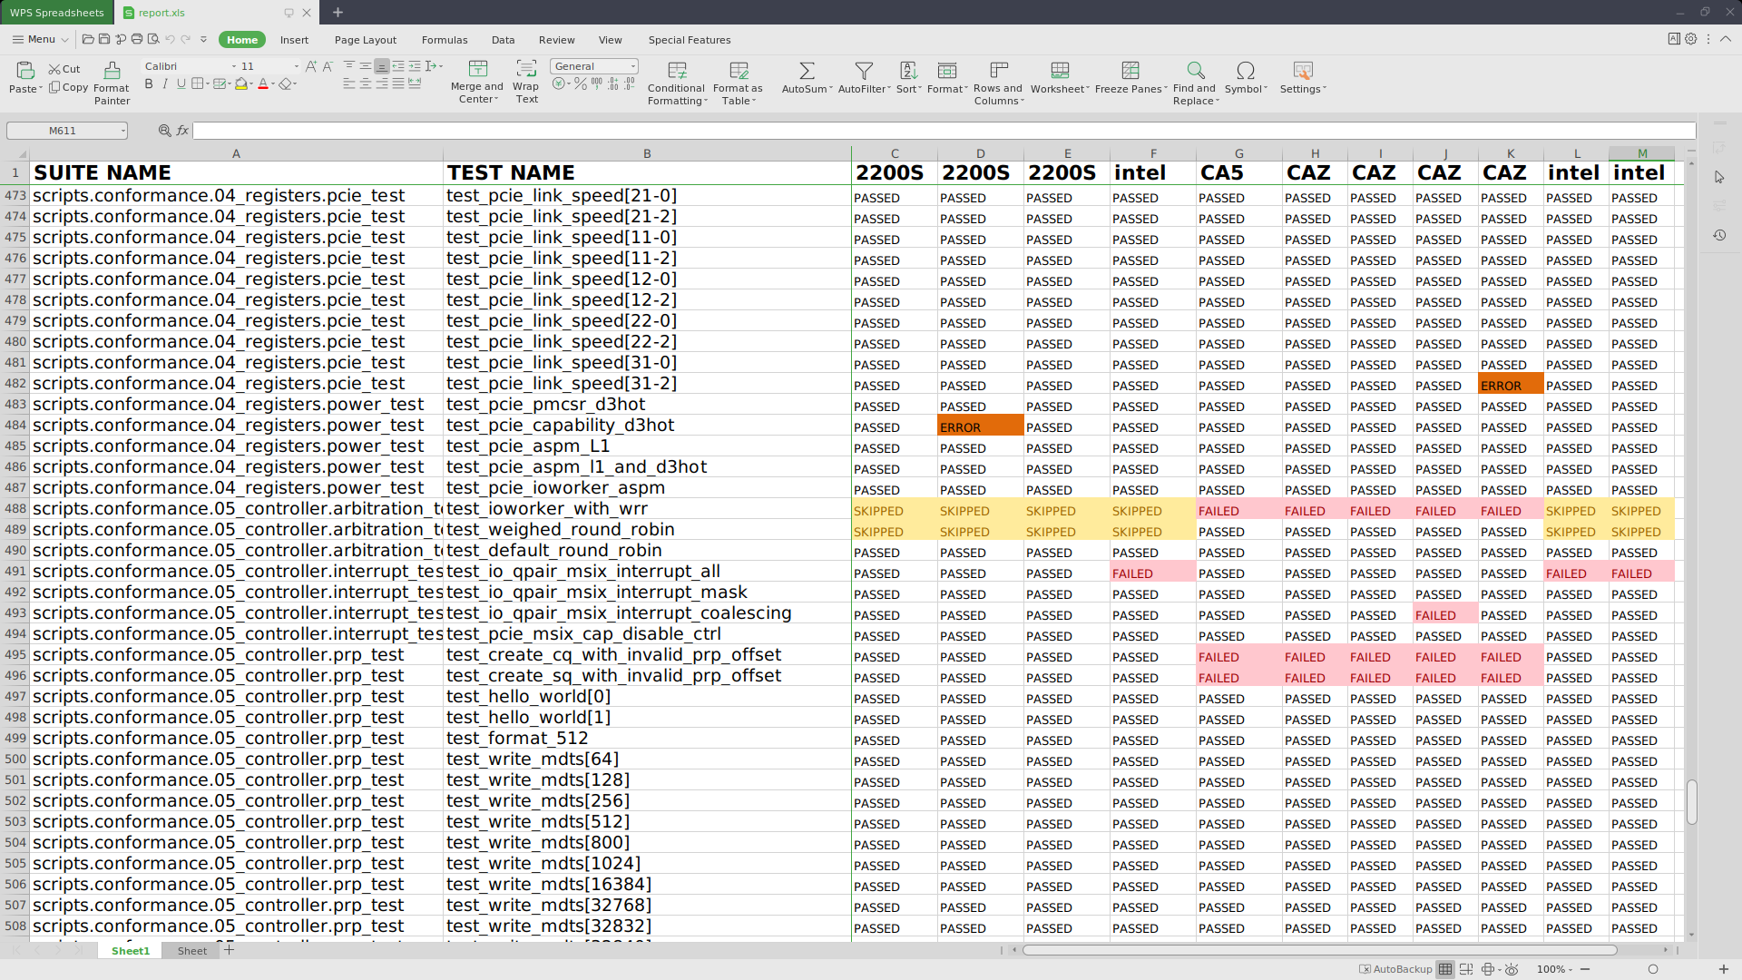
Conformance Test Scripts
https://github.com/pynvme/conformance
GPL-3.0
suites
registers
admin
nvm
features
controller
TCG
ZNS
Notes:
协助客户开发脚本，提供行业标准测试的脚本。
client行业的trace replayer and recorder。
移植测试框架和脚本。

Slide 44
Enterprise Edition
 | meta mode | command mode | ioworker mode
multiple controllers |  | √ | √
multiple namespaces |  | √ | √
zoned namespace |  | √ | √
namespace mgmt |  | √
reservation command |  | √
SGL | √ | √ | √
metadata |  | √
E2E data protection (PI) |  | √
CMB (SQ) | √
latency histogram |  |  | √

Slide 45
Zone Class
slba
wpointer
capacity
size
Zone.state
Empty
Implicitly Opened
Explicitly Opened
Closed
Read Only
Full
Offline
Zone actions: applied to all physical zones in a super zone
close()
finish()
open()
reset()
offline()
set_descriptor_extension()
IO:
read(offset)
write(offset)
ioworker()

Slide 46
Super Zone
elba
slba
capacity
size

Slide 47
ioworker: fill super zone
elba
slba
capacity
size
maximize opened zone count
increase write bandwidth
avoid the LBA holes between capacity and size
leverage the step parameter of ioworker
notes:
1. enough qdepth: 8*(physical zone count)
2. 100% write in one ioworker. Mixed read in another ioworker.
def test_zns_write_super_zone_basic(nvme0n1, buf, qpair, nzones=1):
Zone(qpair, nvme0n1, 0, 0x4000*nzones).reset().\
ioworker(io_size=32, io_count=384*nzones, qdepth=8*nzones).start().close()

Slide 48


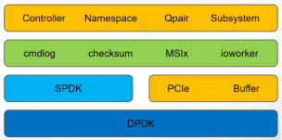
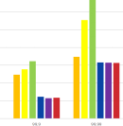

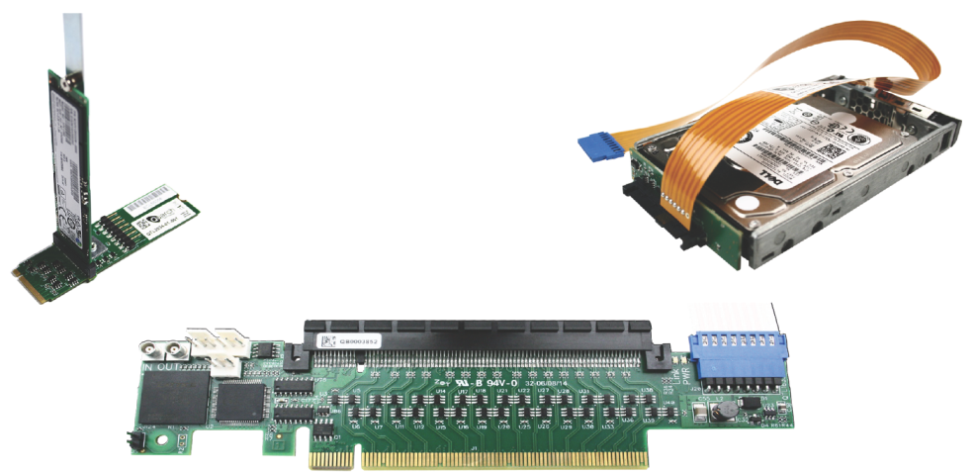
Values
Ecosystem
Scripts
Expendability
Hardware
Performance
Service
Notes:
强大的生态：我们提供原生的Python扩展包，通过API开放100%的功能。不同于其他封闭的测试软件，Pynvme为你接入强大并且开放的Python软件生态，获得来自整个业界的助力。
高效的脚本：Pynvme是一个测试工具，更是一个SDK。利用我们的API以及VSCode插件，用户可以在SSD测试中得到互联网时代的脚本开发体验和效率。
丰富的硬件：Pynvme可以运行于各种常见的笔记本电脑、台式机甚至服务器之上，也支持各种电源控制、错误注入等第三方生产测试工具。
灵活的扩展：Pynvme抽象了测试系统中各个层次的功能。通过对PCIe设备和物理内存的直接访问，可以在Python脚本中二次开发各种功能。
真实的性能：Pynvme具有业界最高的带宽、IOPS以及最低的延迟，并且保证测试数据的稳定和可重现，为用户度量最真实的SSD性能。
敏捷的服务：Pynvme向用户提供兼容IoL、SNIA等业界标准的测试脚本。并且基于Pynvme强大的脚本开发和扩展能力，我们可以快速为用户定制和移植测试的软硬件环境和脚本。

Slide 49

http://pynv.me/3/
Thanks!
Notes:
pynvme is a software-defined high performance and reliable python extension collaborating SSD test engineers to efficiently develop their tests on function, performance and reliablity.

